Slide 1

CLOUD AGNOSTICS MLOPs PIPELINE
HASHEDIN UNIVERSITY
HU SDET DEVOPS 1.0
Team:
DARSHAN BALAJI P S
NAVNEET
GUNASEKAR S
TEJAS MANU S
DISHA D SHETTY
Mentors:
AAYUSHI SINGH(DC DevOps Engineer III)
KOPAL CHAKRAVARTHY(DC DevOps Engineer I)

Slide 2
CONTENTS
Cloud agnostics
Machine learning stages
MLOPS
Kubeflow
What’s in the box
Kubeflow architecture
Kubeflow pipeline
Anatomy of a pipeline
Tech stack
Implementation
Conclusion and future scope

Slide 3
CLOUD AGNOSTICS
A cloud-agnostic architecture strategy focuses on designing applications that can run seamlessly in any cloud environment. Cloud-agnostic applications and services are not dependent on the limited toolchains of one major cloud platform.
What’s the difference between cloud agnostic and cloud native?
Cost
Time to market
Flexibility
Scalability
Efficiency
Reliability

Slide 4
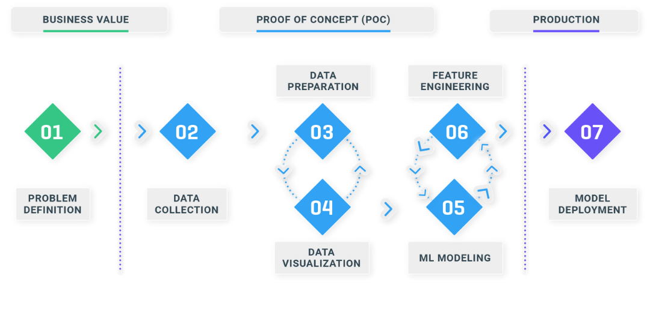
MACHINE LEARNING STAGES

Slide 5
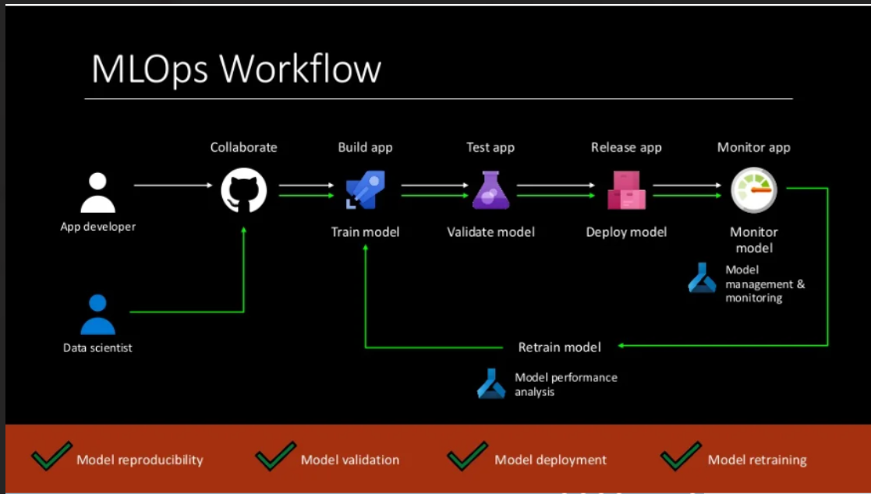
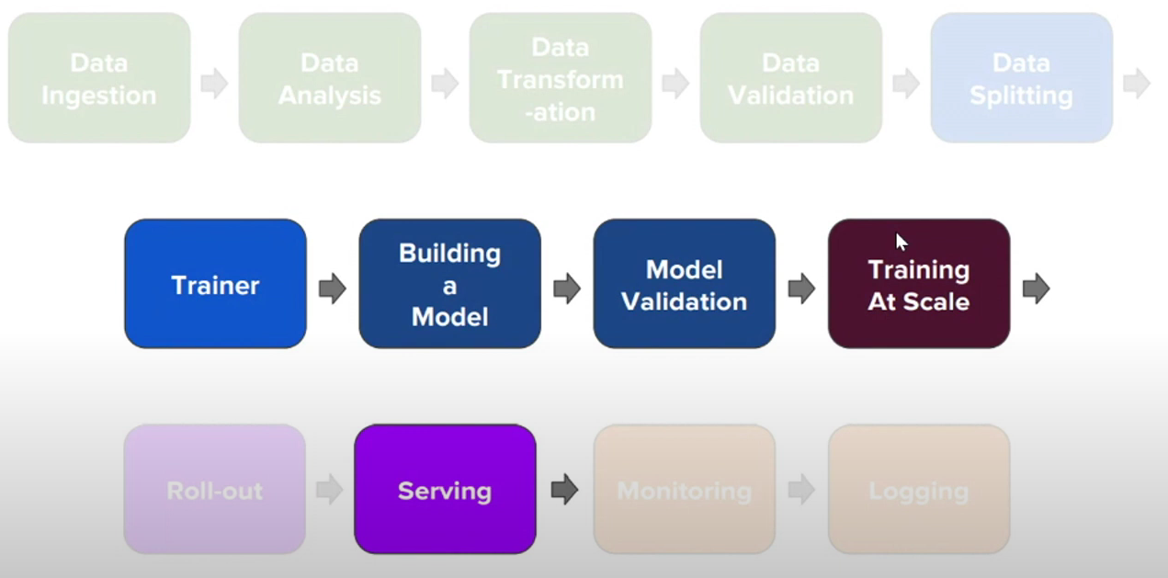
MLOPS

Slide 6
KUBEFLOW
Make easy for everyone to develop, deploy and manage portable, Scalable everywhere.
Why Kubeflow?
Composability
Choose from existing popular tools
Portability
Built using cloud native, portable Kubernetes API’s
Scalability
TF already supports CPU/GPU/Distributed
K8s scales to 5k nodes with same stack

Slide 7
What’s in the Box?
Jupyter Hub – For Collective and Interactive Training.
A TensorFlow Training Controller
A Tensorflow Serving Deployment
Agro for workflows
Much more

Slide 8
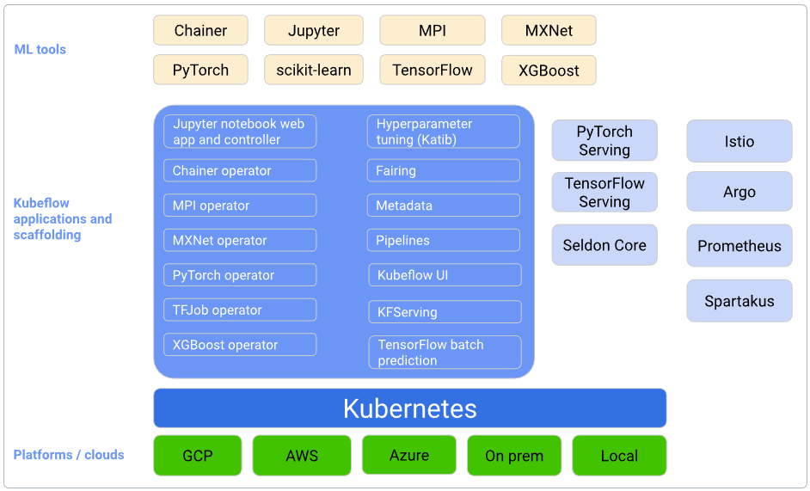
KUBEFLOW ARCHITECTURE

Slide 9
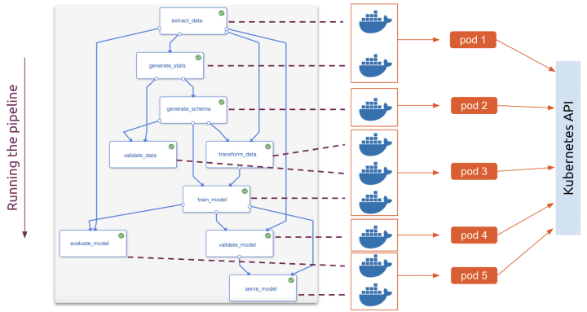
Kubeflow Pipelines
Kubeflow Pipelines is a platform for building and deploying portable, scalable machine learning (ML) workflows based on Docker containers.
Kubeflow Pipelines platform consists of:
Notebooks for interacting with the system using the SDK.
A user interface (UI) for managing and tracking experiments, jobs, and runs.

Slide 10
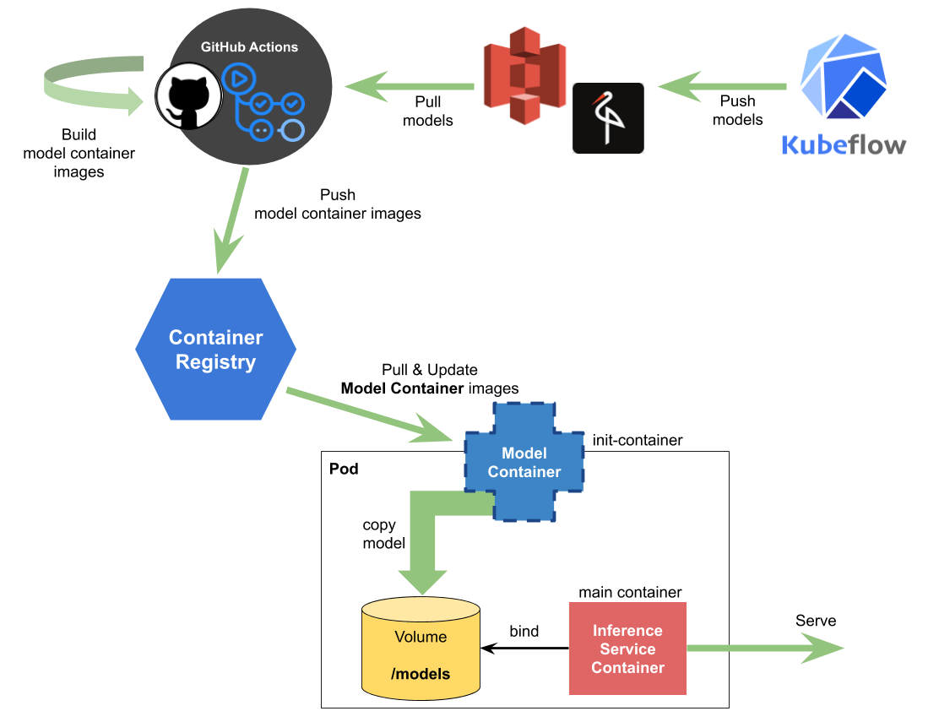
ANATOMY OF A PIPELINE
Containerized implementations of ML tasks
Pre-built components: Just provide params or code snippets. Create your own components from code or libraries.
Use any runtime, frameworks or datatypes
Attach k8s object – volumes, Secrets
Specification of the sequence of steps
Specified via python DSL
Inferred from data dependencies on input/output
Input Parameters
A “Run” = Pipeline involved w/ specific parameters
Schedules
Invoke a single run or create a recurring scheduled pipeline

Slide 11
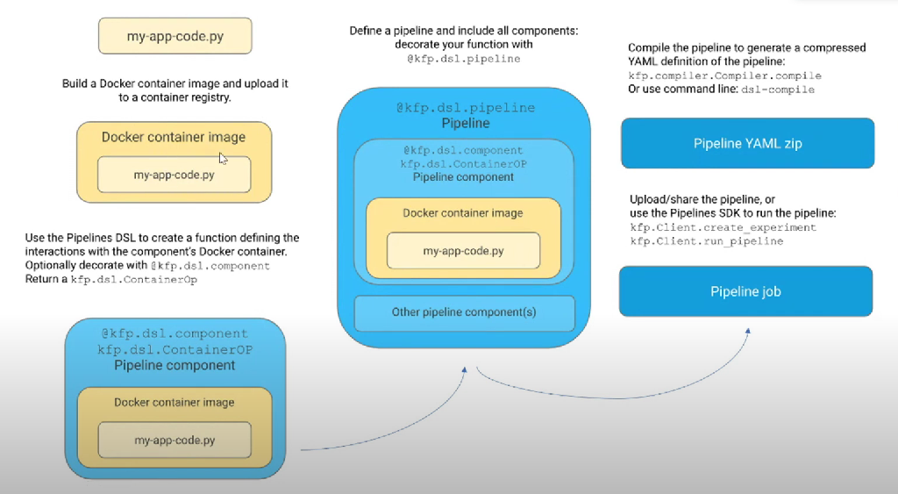

Slide 12
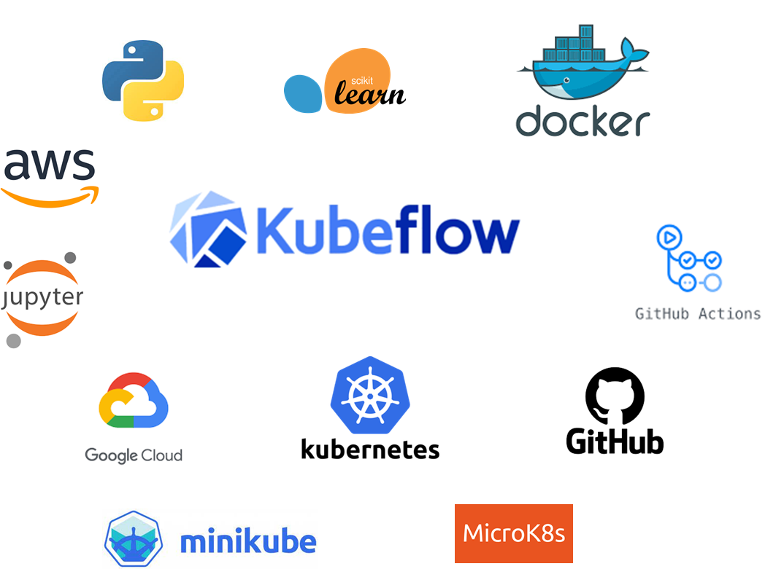
TECH STACK

Slide 13
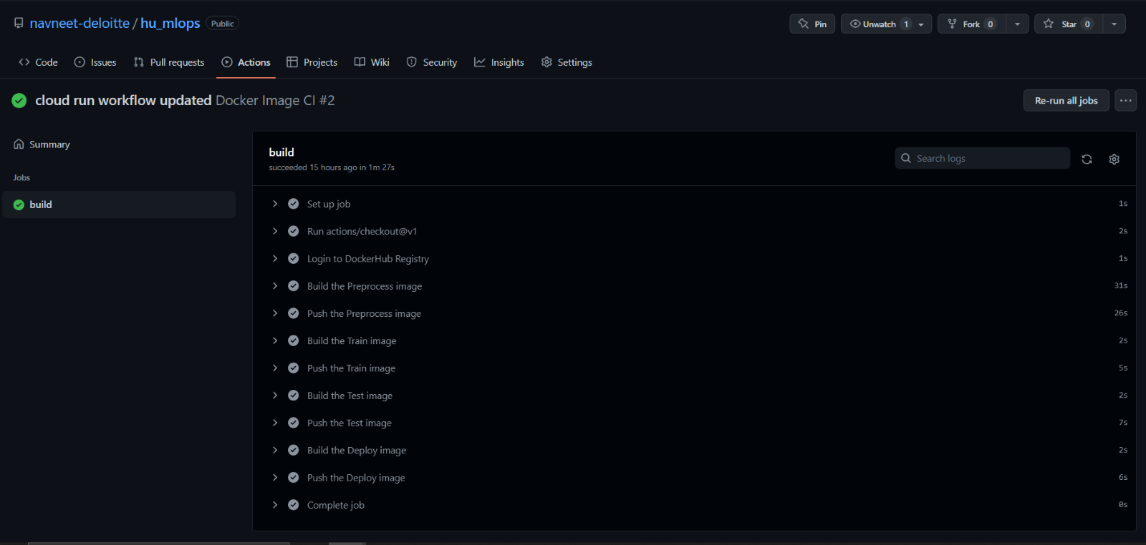
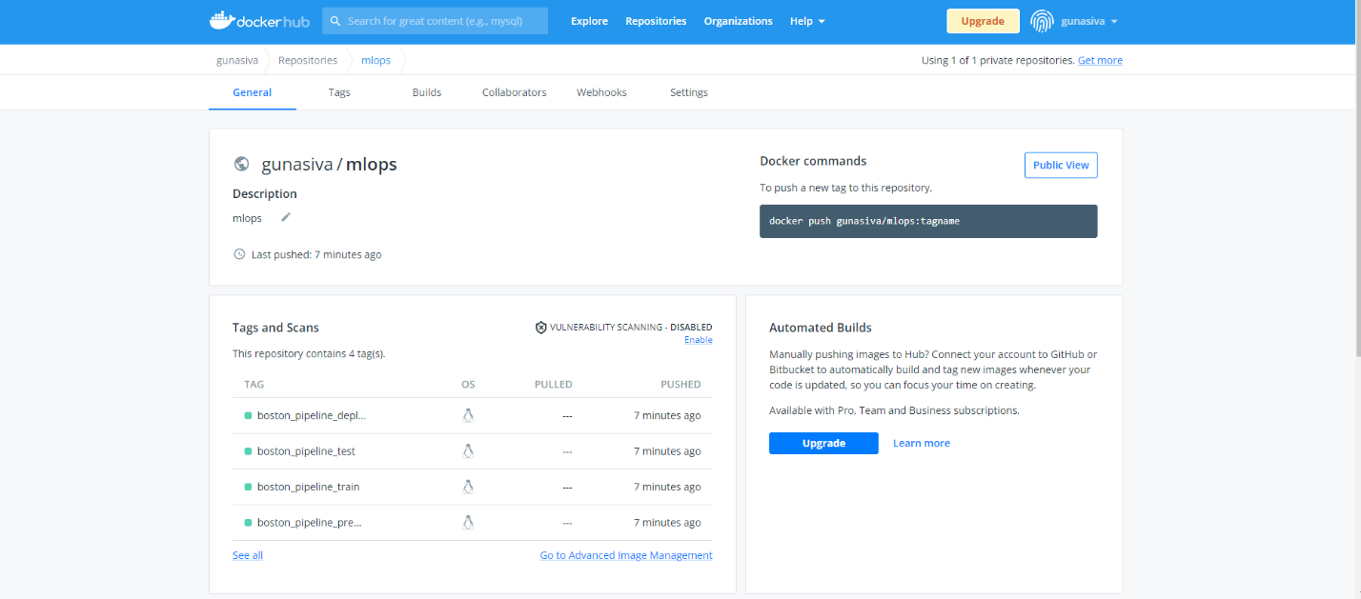
IMPLEMENTATION
containerizing the model:

Slide 14
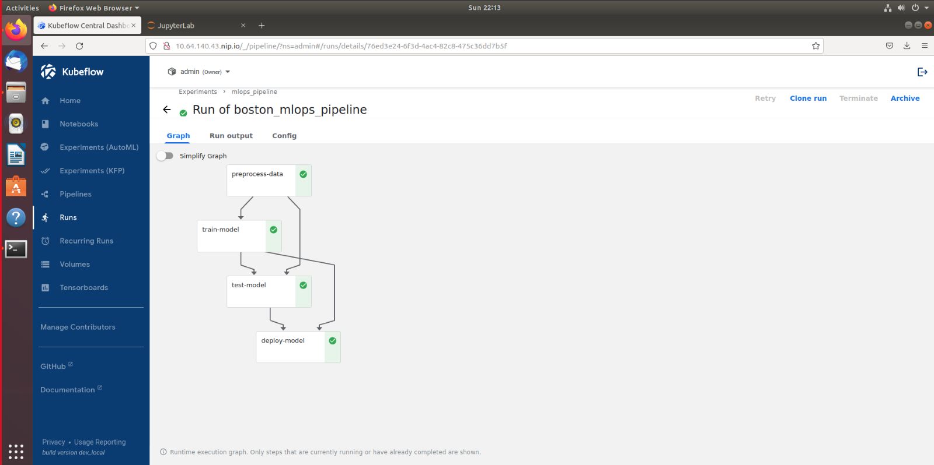
IMPLEMENTED MLOPS PIPLELINE

Slide 15
CONCLUSION AND FUTURE SCOPE
A cloud agnostic Kubeflow pipeline is been implemented using docker hub , gitHub actions and Kubeflow and can be visualized using graph.
Only the automation of containerizing the model is been introduced in this project and can be further improvised by automating the pipeline run when a new version of the image is pushed into the repository.
The pipeline can be further used for deploying the model to any cloud platform by specifying its configuration required.

Slide 16
THANK YOU

Slide 17
Q and A

